Slide 1
Introduction to Big Data Analytics
Module 1

Slide 2
Overview of the Chapter
Introduction to Big Data
Big Data characteristics
types of Big Data
Traditional vs. Big Data business approach
Big Data Challenges
Examples of Big Data in Real Life
Big Data Applications

Slide 3
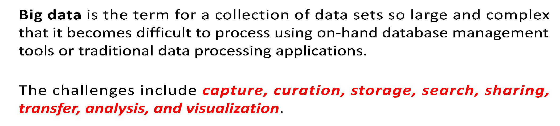
“Big Data is the frontier of a firm's ability to store, process, and access (SPA) all the data it needs to operate effectively, make decisions, reduce risks, and serve customers.”
-- Forrester

Slide 4
“Big Data in general is defined as high volume, velocity and variety information assets that demand cost-effective, innovative forms of information processing for enhanced insight and decision making.”
-- Gartner

Slide 5
“Big data is the data characterized by 3 attributes: volume, variety and velocity.”
“Big data is the data characterized by 4 key attributes: volume, variety, velocity and value.”
-- IBM
-- Oracle

Slide 6
Velocity…
…refers to the speed at which new data is generated and the speed at which data moves around.
Just think of social media messages going viral in seconds. Technology allows us now to analyse the data while it is being generated (sometimes referred to as in-memory analytics), without ever putting it into databases.

Slide 7
Variety…
…refers to the different types of data we can now use.
In the past we only focused on structured data that neatly fitted into tables or relational databases, such as financial data.
In fact, 80% of the world’s data is unstructured (text, images, video, voice, etc.)
With big data technology we can now analyse and bring together data of different types such as messages, social media conversations, photos, sensor data, video or voice recordings

Slide 8
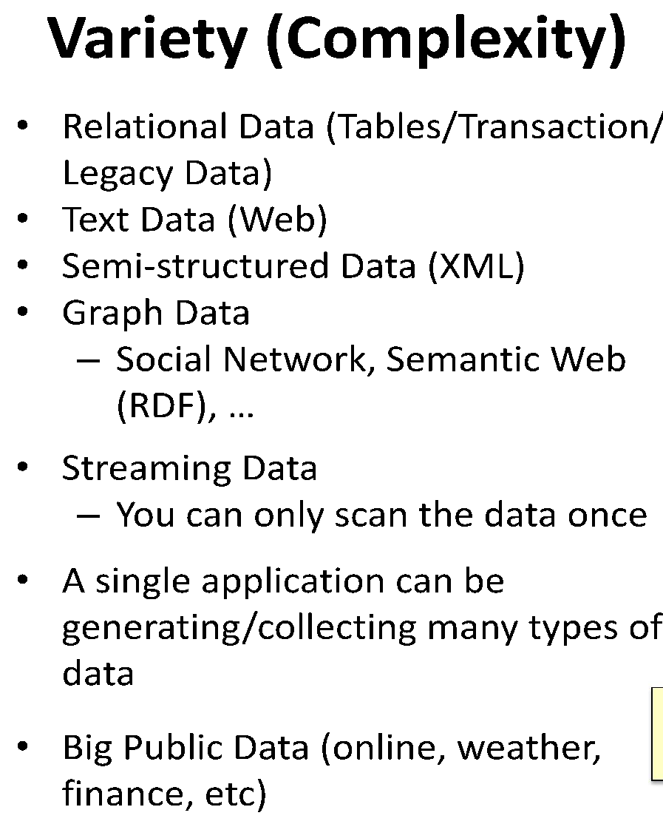
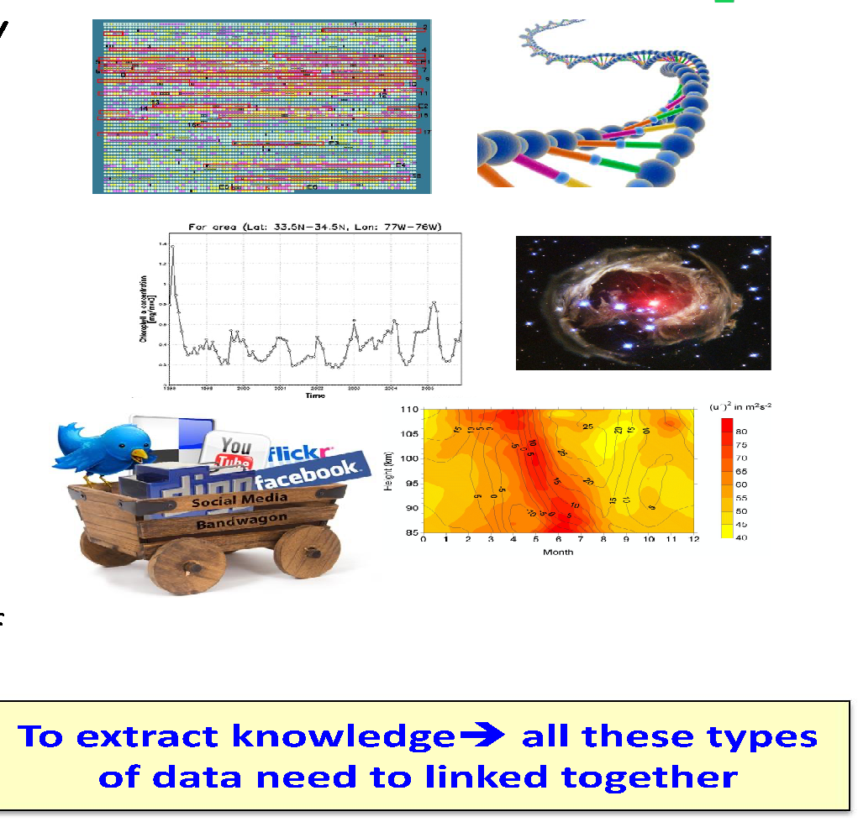

Slide 9
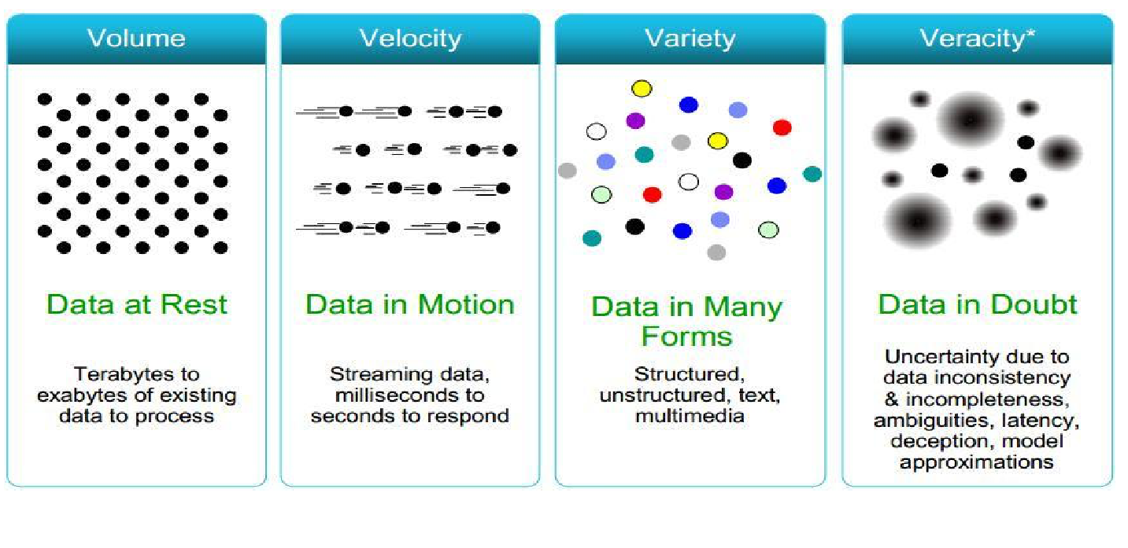
4 Vs ??

Slide 10
Veracity…
…refers to the messiness or trustworthiness of the data.
With many forms of big data quality and accuracy are less controllable (just think of Twitter posts with hash tags, abbreviations, typos and colloquial speech as well as the reliability and accuracy of content) but technology now allows us to work with this type of data

Slide 11
Volume…
…refers to the vast amounts of data generated every second.
We are not talking Terabytes but Zettabytes or Brontobytes. If we take all the data generated in the world between the beginning of time and 2008, the same amount of data will soon be generated every minute.
New big data tools use distributed systems so that we can store and analyse data across databases that are dotted around anywhere in the world.

Slide 12
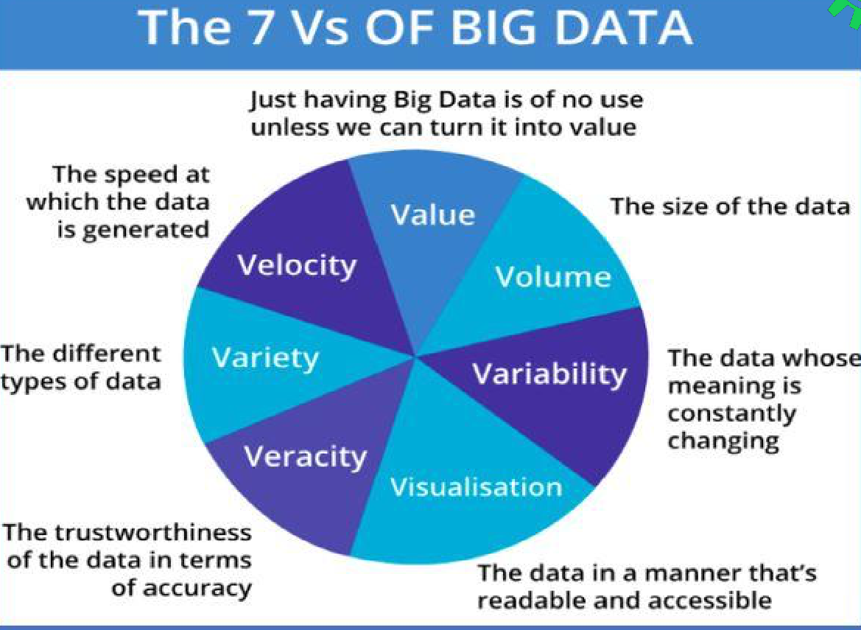

Slide 13

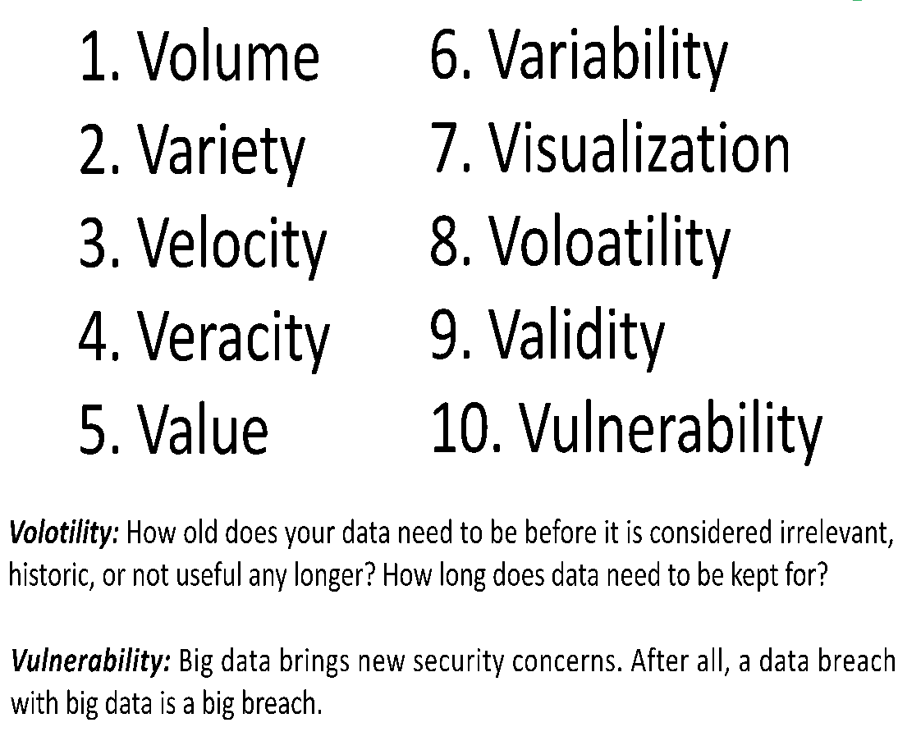

10 Vs At the last count 42 Vs were documented

Slide 14
Activity Data
Simple activities like listening to music or reading a book are now generating data.
Digital music players and eBooks collect data on our activities.
Your smart phone collects data on how you use it and your web browser collects information on what you are searching for.
Your credit card company collects data on where you shop and your shop collects data on what you buy.
It is hard to imagine any activity that does not generate data.

Slide 15
Conversation Data
Our conversations are now digitally recorded. It all started with emails but nowadays most of our
conversations leave a digital trail.
Just think of all the conversations we have on social media sites like Facebook or Twitter.
Even many of our phone conversations are now digitally recorded.

Slide 16
Photo and Video Image Data
Just think about all the pictures we take on our smart phones or digital cameras.
We upload and share 100s of thousands of them on social media sites every second.
The increasing amounts of CCTV cameras take video images and we up-load hundreds of hours of video images to YouTube and other sites every minute .

Slide 17
Sensor Data
We are increasingly surrounded by sensors that collect and share data.
Take your smart phone, it contains a global positioning sensor to track exactly where you are every second of the day, it includes an accelometer to track the speed and direction at which you are travelling.
We now have sensors in many devices and products.

Slide 18
The Internet of Things Data
We now have smart TVs that are able to collect and process data, we have smart watches, smart fridges, and smart alarms.
The Internet of Things, or Internet of Everything connects these devices so that e.g. the traffic sensors on the road send data to your alarm clock which will wake you up earlier than planned because the blocked road means you have to leave earlier to make your 9am meeting… .

Slide 19
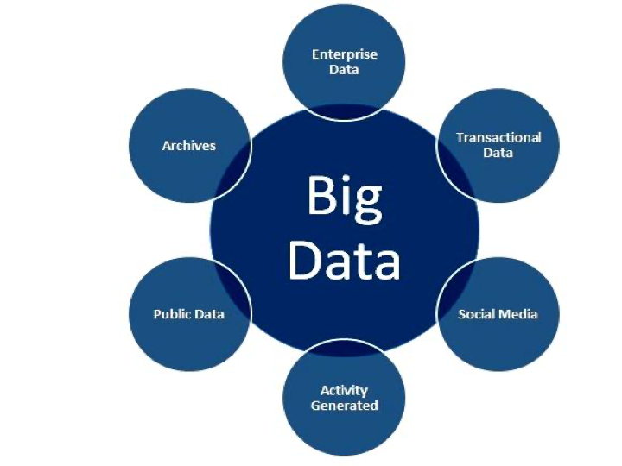
BIG DATA SOURCES

Slide 20
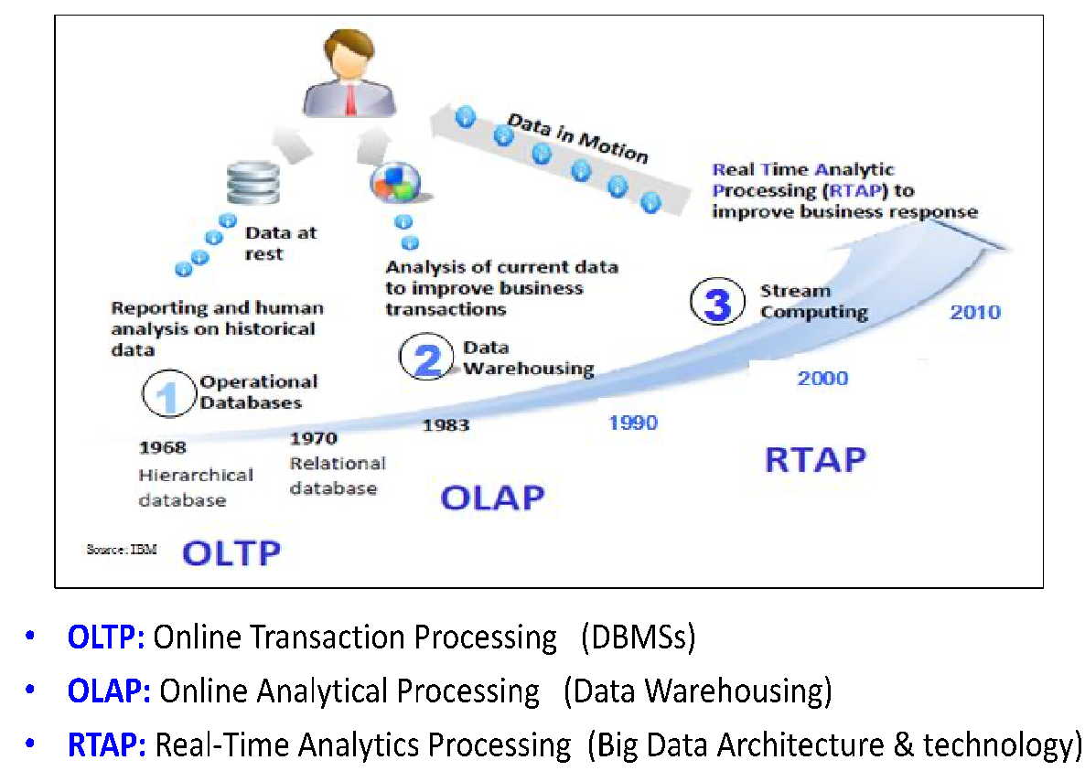
EVOLUTION OF BIG DATA

Slide 21
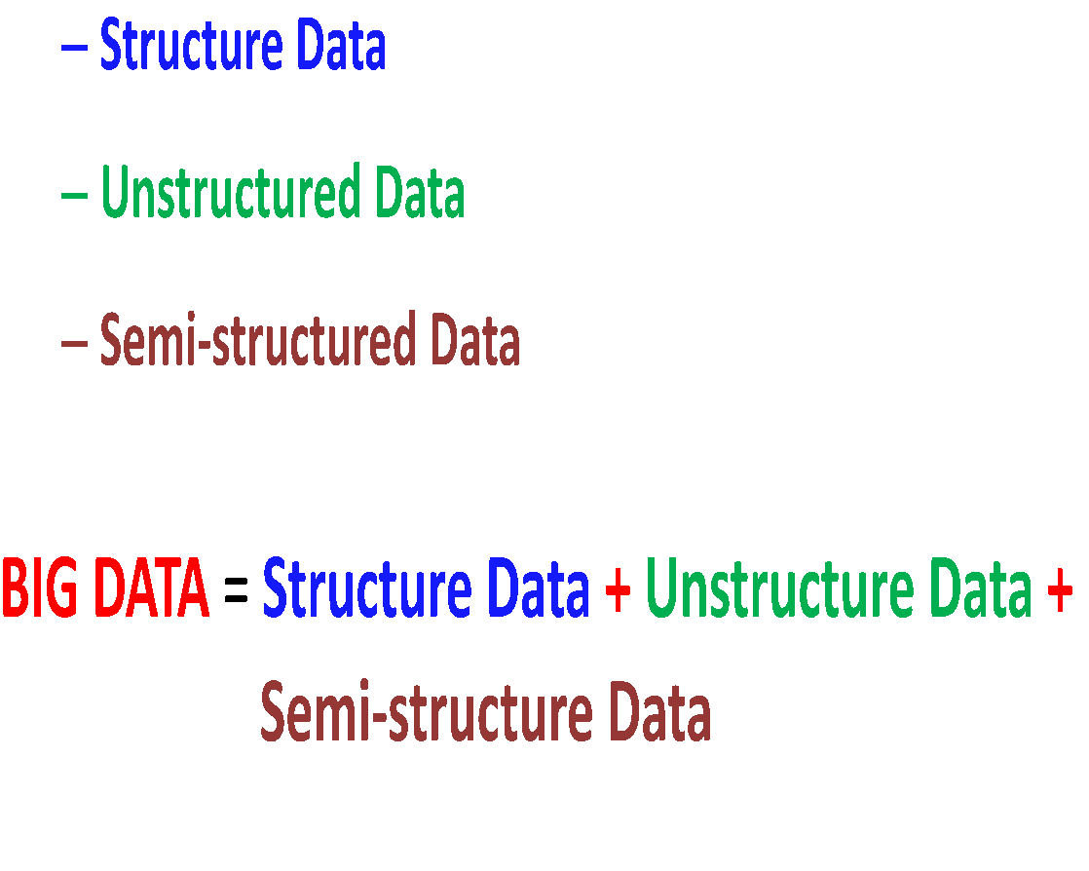
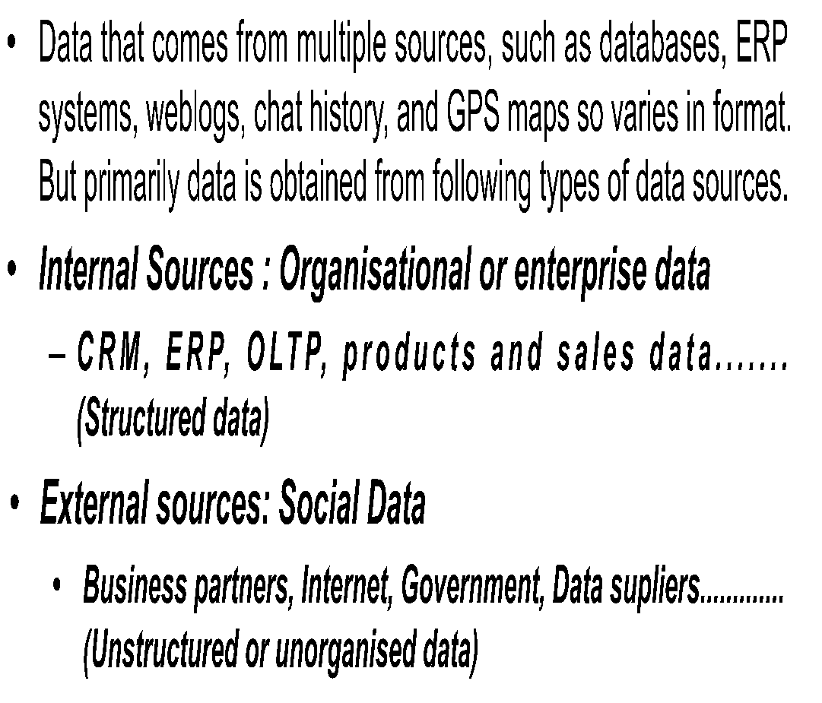
TYPES OF DATA

Slide 22
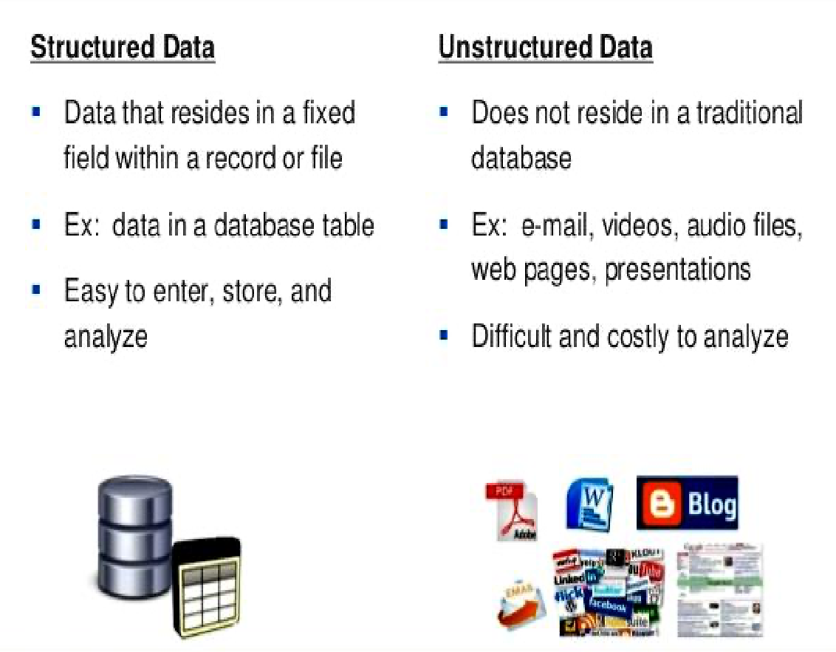
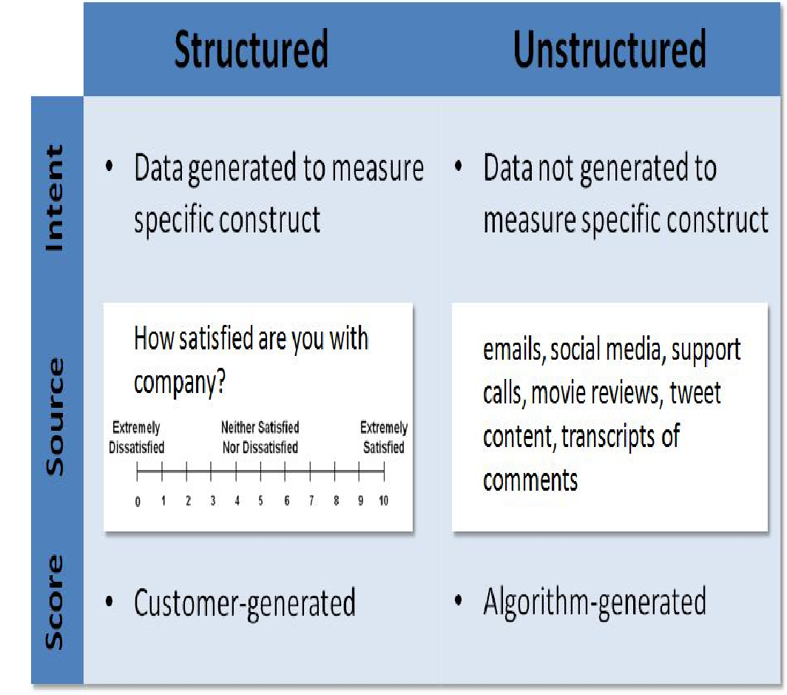

Slide 23
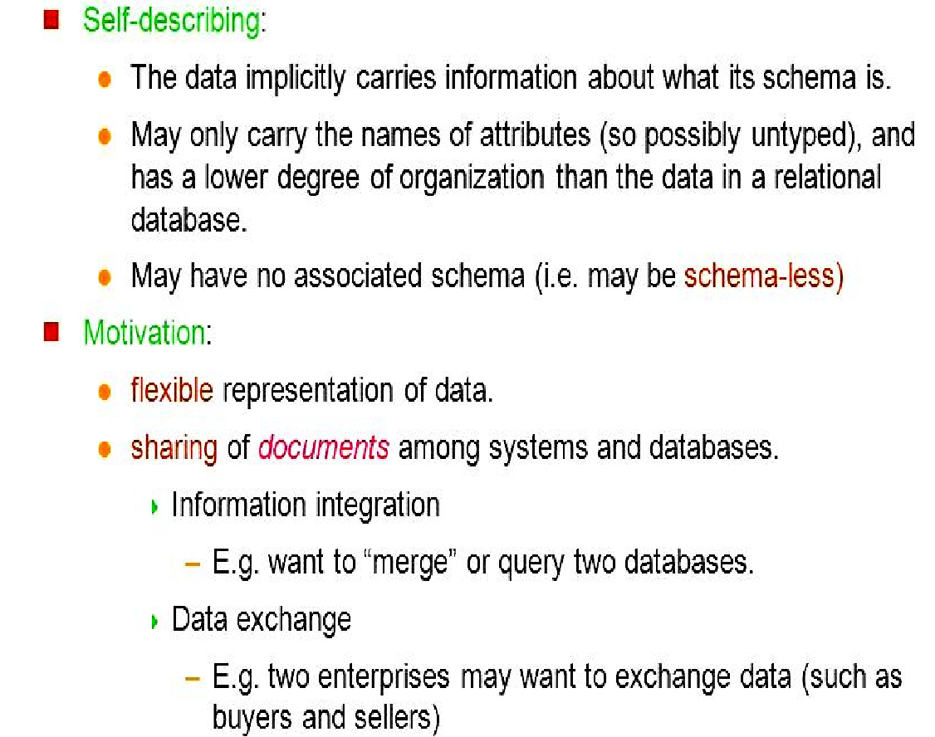
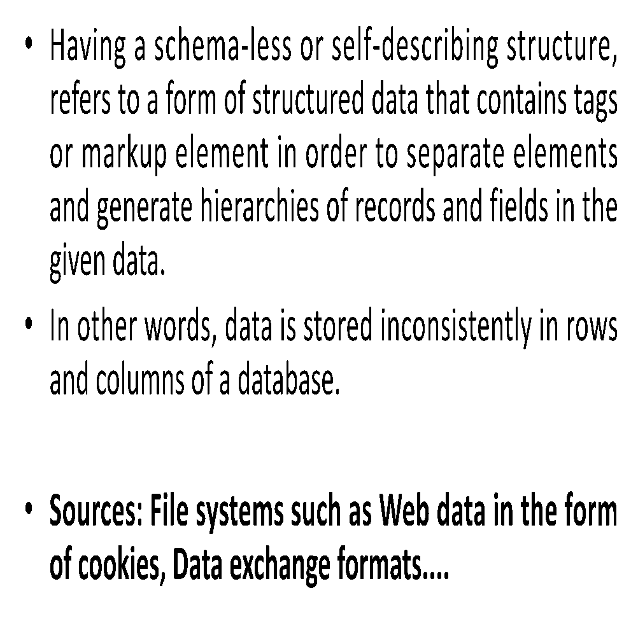
SEMISTRUCTURED DATA

Slide 24
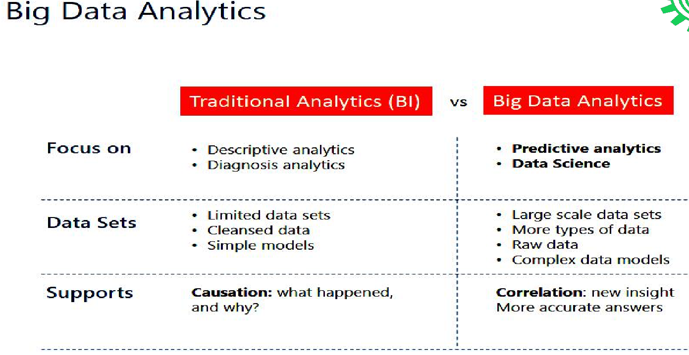

Slide 25
Types of Analytics
The main goal of big data analytics is to help organizations make smarter decisions for better business outcomes.
3 distinct types of analytics
Descriptive Analytics:
Predictive Analytics
Prescriptive Analytics

Slide 26
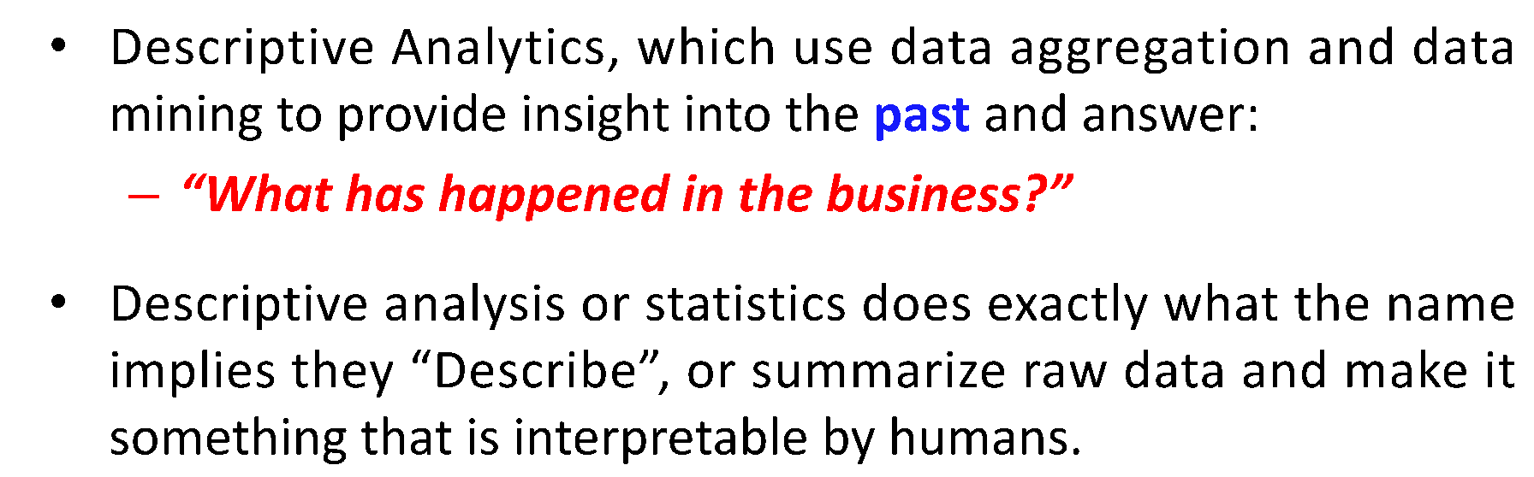
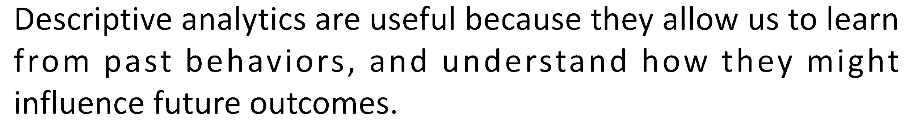

Descriptive Analytics- Insights Into The Past

Slide 27
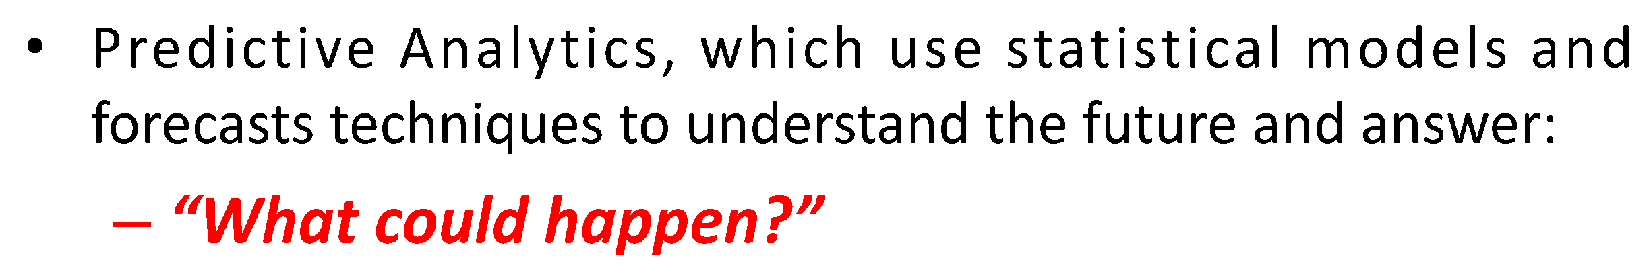
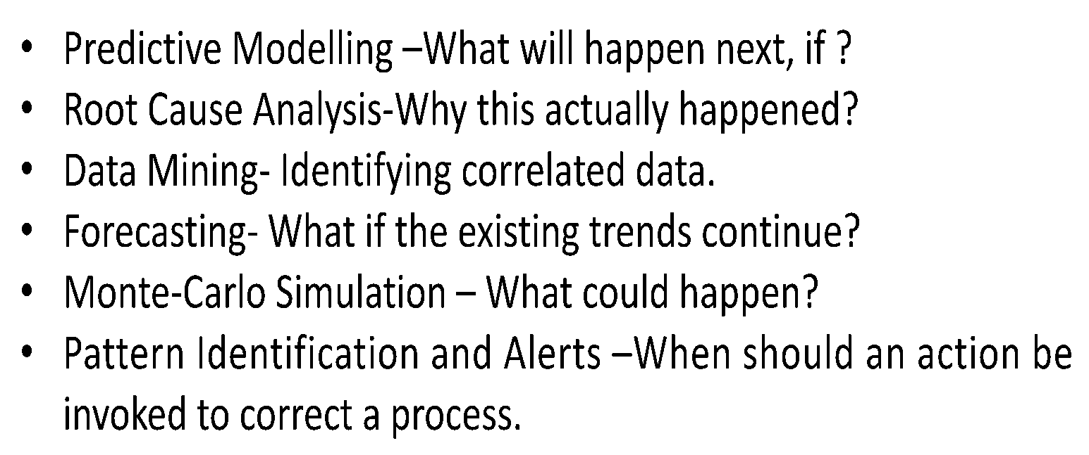
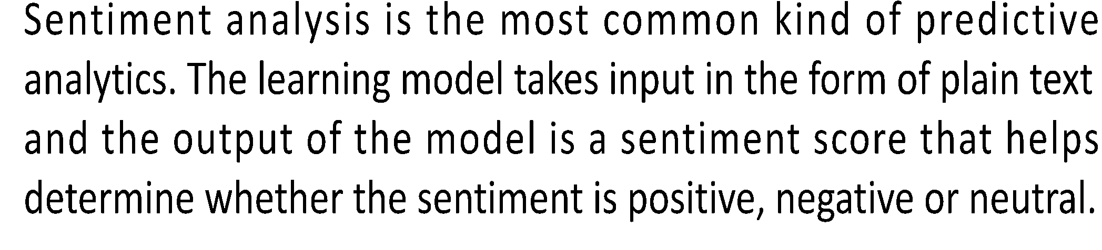
Predictive Analytics

Slide 28
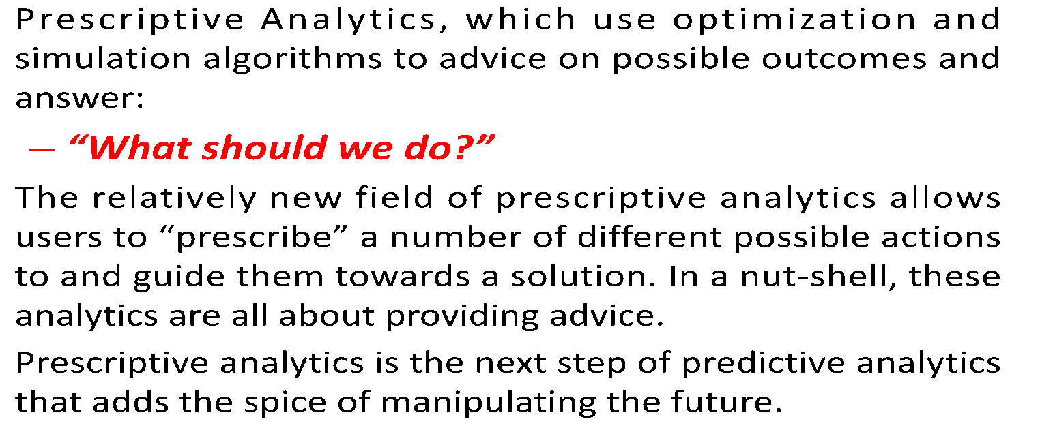
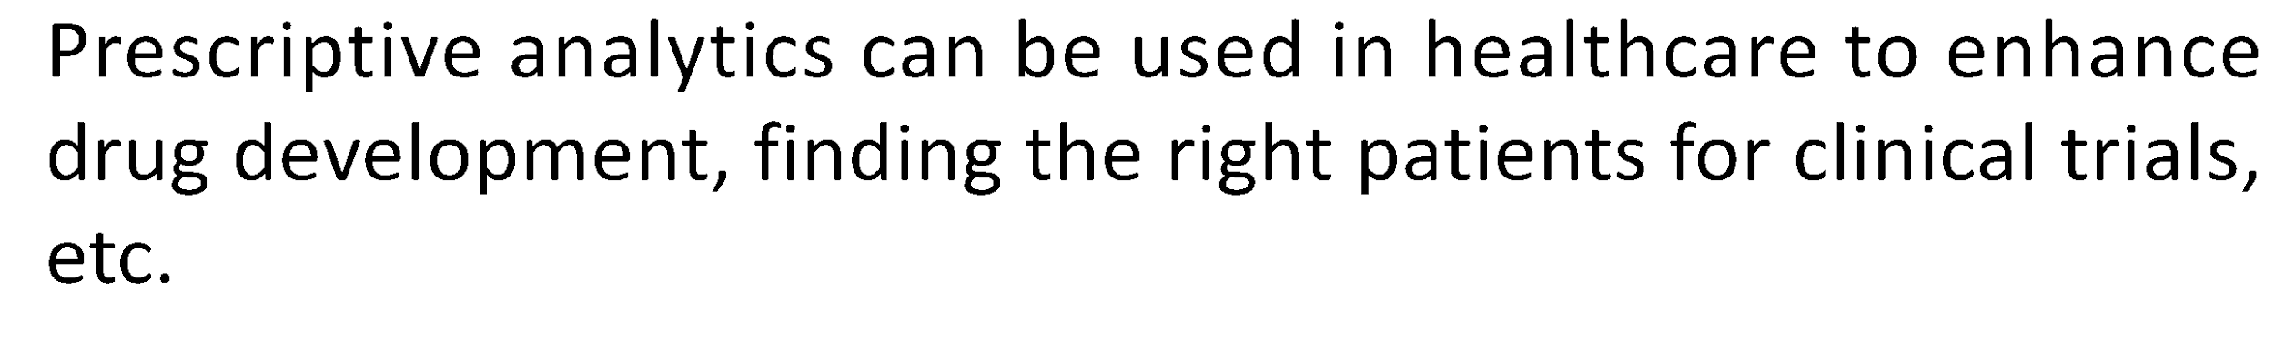
Prescriptive Analytics- Advise On Possible Outcomes

Slide 29
BIG DATA ANALYTICS
Applications

Slide 30
REAL WORLD BIG DATA EXAMPLES
Discovering consumer shopping habits
Personalized marketing
Fuel optimization tools for the transportation industry
Monitoring health conditions through data from wearables
Live road mapping for autonomous vehicles
Streamlined media streaming
Predictive inventory ordering
Personalized health plans for cancer patients
Real-time data monitoring and cybersecurity protocols

Slide 31
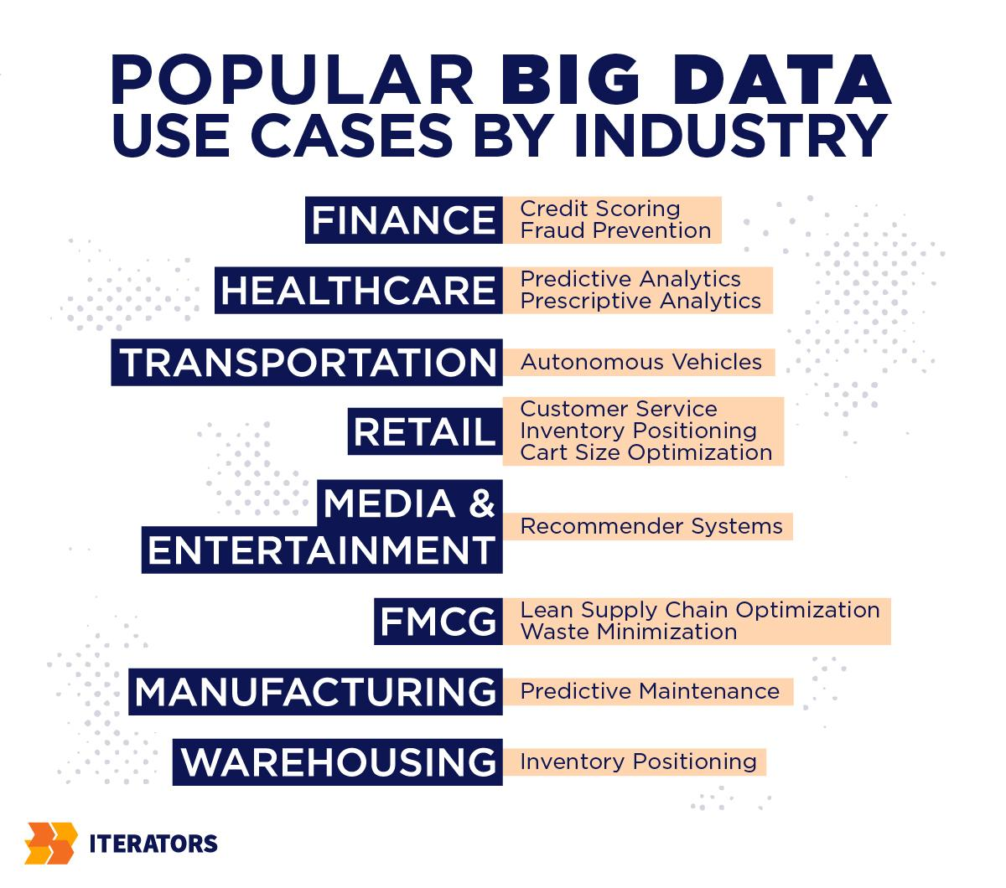

Slide 32
Applications – Indian Scenario
Banking - Fraud detection, Loan appraisals
Online Shopping – Targeted Advertising
Vital Monitoring – personal data, activity, health
Energy Optimization
Logistics
Healthcare = allied health care, targeted medicine
Media and entertainment – recommendations, curated content
Education

Slide 33
Improving Sports Performance:
Most elite sports have now embraced big data analytics.
Many use video analytics to track the performance of every player in a football or baseball game.
Sensor technology is built into sports equipment such as basket balls or golf clubs, and many elite sports teams track athletes outside of the sporting environment – using smart technology to track nutrition and sleep, as well as social media conversations to monitor emotional wellbeing.

Slide 34
Big Data vs AI
Big data and artificial intelligence are interdependent.
Although each discipline is distinct, the presence of each is crucial in allowing for the other to function at its highest degree.
Big data provides a vast sample of this information, making it the gas that fuels top-end artificial intelligence systems.
By harnessing big data resources, artificial intelligence systems can make more informed decisions.

